Slide 1

Supply Chain Dashboard
Presented by :Youssef Shaban

Slide 2
Project Idea
Brief description of the problem being solved: Organizations often face difficulties in optimizing their supply chain due to fragmented data and limited visibility into supplier performance, logistics efficiency, product quality, and cost control.
Overview of the proposed solution: This project introduces an interactive dashboard built with Power BI, utilizing a structured dataset of 100 records that covers various supply chain dimensions. The process includes data cleaning, KPI development, and dashboard design to transform raw data into actionable insights.
Unique value proposition: The dashboard enables real-time, data-driven decision-making by providing a unified view of critical supply chain metrics. Its interactivity and user-focused design help stakeholders quickly identify inefficiencies and opportunities for improvement.

Slide 3
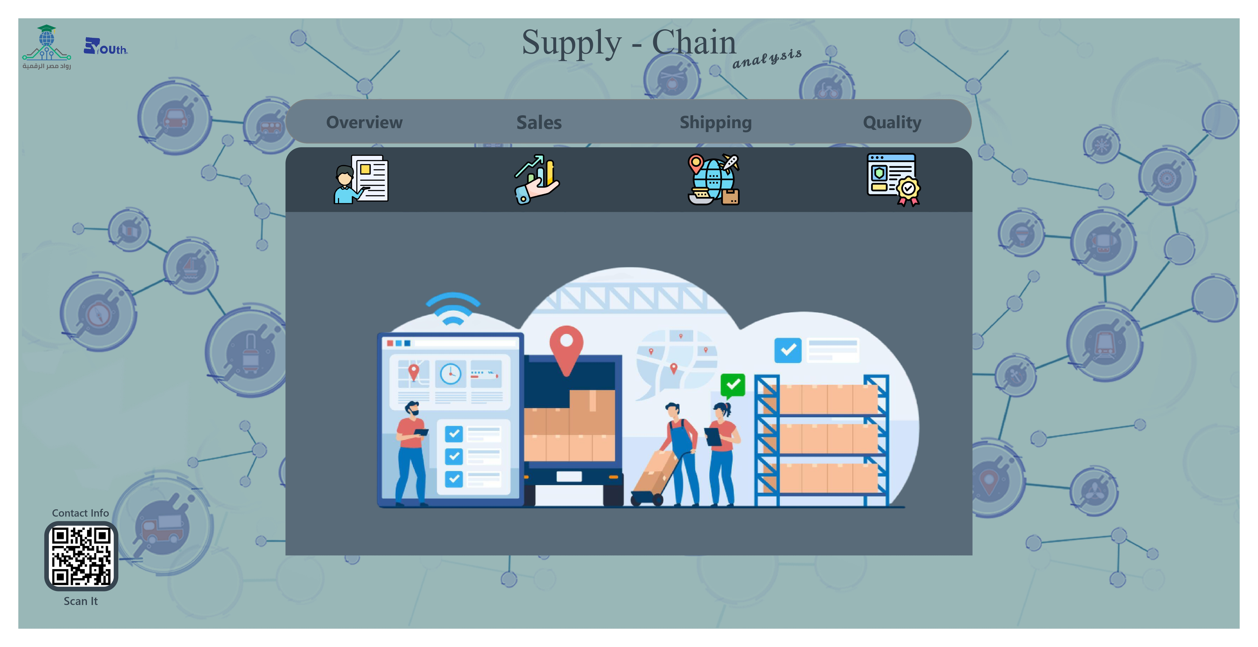
The Dashboard includes a Homepage with a clean tabbed layout that directs users to four main sections: Overview, Sales, Shipping, and Quality. Each section features customized visuals such as bar charts, pie charts, KPIs, and Maps to support Supply Chain Analysis.
Project Wireframe
The interface is designed with intuitive navigation and user-friendly visuals. Icons and color-coded sections help users quickly locate key information. Interactive filters and slicers allow users to explore data dynamically based on region, product, or supplier, ensuring a smooth and insightful experience for both technical and non-technical users..

Slide 4
End Users & Features
Primary End Users (Personas):
Supply Chain Managers – Monitor performance, optimize logistics, and manage suppliers.
Operations Analysts – Perform in-depth analysis to identify inefficiencies or trends.
Executives/Decision-Makers – Review KPIs to support strategic planning.
Quality Control Teams – Track defect rates and inspection outcomes to improve product quality
Key Features Addressing User Needs:
Interactive KPIs Dashboard – Real-time metrics like revenue, defect rate, and production efficiency.
Regional Sales Analysis – Visuals filtered by region, gender, and product type.
Logistics Performance – Insights into shipping times, carriers, and cost breakdowns.
Quality Insights – Track inspection results, defect trends, and production volumes.
Filter & Drill-down Capabilities – Dynamic filters by supplier, region, and product for detailed views.
How Features Solve User Problems:
Managers can detect delays or cost spikes early using logistics and supplier metrics.
Analysts benefit from dynamic filtering to perform root-cause analysis across supply chain dimensions.
Executives gain a high-level overview of profitability and performance to guide strategic moves.
Quality Teams identify defective batches or failing suppliers quickly, ensuring better production outcomes.

Slide 5
Data Structure
Architecture:
Single CSV file simulating a relational structure (100 rows × 30 columns) combining product, supplier, logistics, and quality data
Key Features: Mix of numerical & categorical data Balanced across product types (Haircare, Skincare, Cosmetics)Example fields: Product Type, Price, Supplier, Lead Times, Defect Rates, Customer Demographics.
Entities & Relationships : Product ↔ Supplier: Each product linked to a supplier
Product ↔ Logistics: Tracks delivery, cost, and transport
modeProduct ↔ Quality: Includes inspection & defect
metricsCustomer ↔ Sales: Enables segmentation by gender/region
Data Flow: 1- Collected in supply_chain_data.csv 2- Cleaned with Python (Pandas): missing values, outliers, type corrections 3- Exported to cleaned_data.csv 4- Imported to Power BI for visualization and KPI modeling

Slide 6
Programming Languages & Frameworks
Programming Language Used:
Python – for data cleaning, preprocessing, and KPI calculations using Pandas and Jupyter Notebook
Frameworks / Tools:
Power BI – used to build the interactive dashboard and visual reports
Pandas – for data manipulation and analysis
Matplotlib / Seaborn (if used) – for visualizing outliers during preprocessing
Supporting Technologies:
CSV Files – as the main data source (our_data.csv, cleaned_data.csv)
Excel – for organizing initial data before visualization
Power BI Service – to publish and share the final dashboard

Slide 7
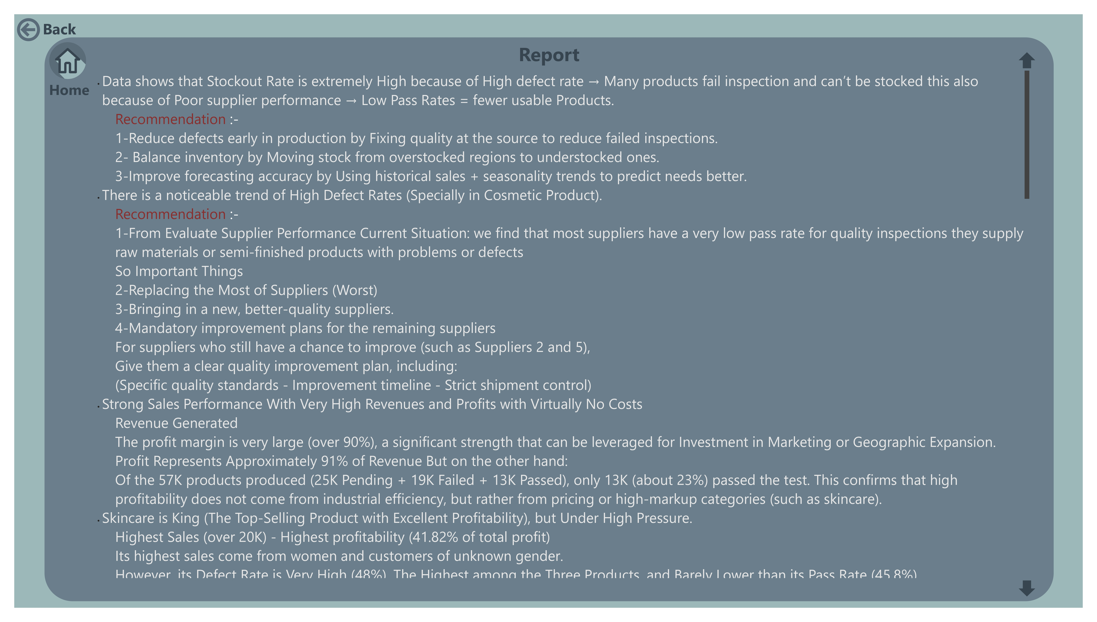
The company is facing a high stockout rate driven by poor product quality and underperforming suppliers, with only 23% of products passing inspection. Skincare, while the top-selling and most profitable category, suffers from a high defect rate (48%), posing a risk to its core customer base. Haircare has moderate sales but poor quality and is mostly purchased by men, while cosmetics perform the worst in both sales and quality. Sales are heavily concentrated in Kolkata (27%), revealing growth potential in other cities like Delhi and Mumbai. The male market remains largely untapped across all categories. Operational issues include overdependence on Carrier B, questionable shipping cost data (air vs road), and imbalanced inventory distribution. To address these challenges, the company should improve quality at the source, replace or support suppliers based on performance, realign inventory across regions, target men with dedicated product lines, and expand successful strategies to new markets while optimizing logistics and clearing unsold stock.
Deliverables

Slide 8
Deliverables . cont
Timeline & Milestones:
Week 1–2: Data collection & understanding
Week 3: Data cleaning & KPI development
Week 4: Dashboard design in Power BI
Week 5: Evaluation, feedback, and final adjustments
Week 6: Submission of final deliverables
Final Products:
Fully functional Power BI dashboard (Supply_Chain_Dashboard.pbix)
Cleaned dataset (cleaned_data.csv)
Python source code (for preprocessing & KPI calculations)
Screenshots of dashboard pages
Optional: Published dashboard via Power BI Service

Slide 9
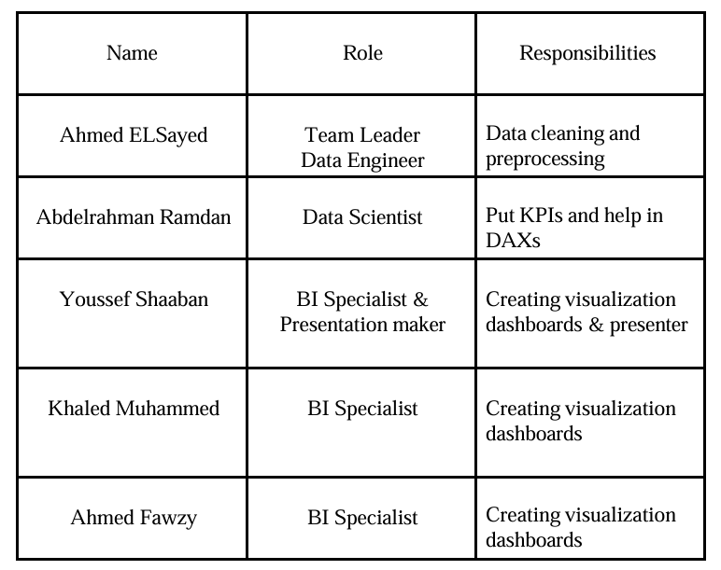
Group Members & Roles:

Slide 10

Thank You ☺
Contact Us

